Slide 1


Automatic Detection of Closed Ring of Wind in Medicanes using Machine Learning
By Angel Li
Undergraduate Student at Princeton University
Class of 2027
Notes:
Must cite Medicane project

Slide 2
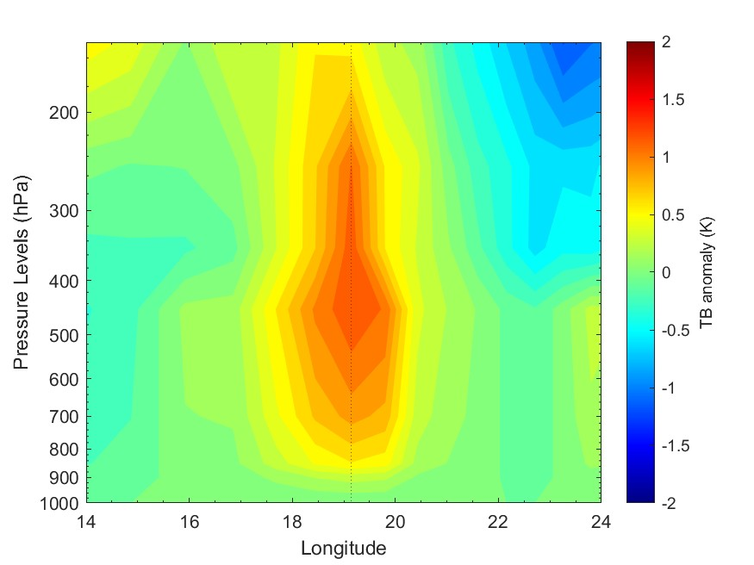
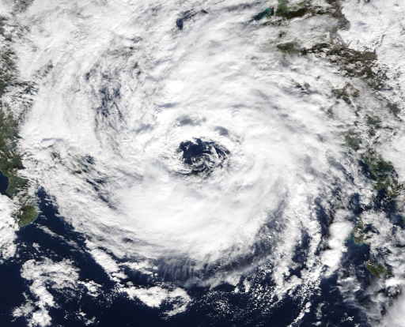
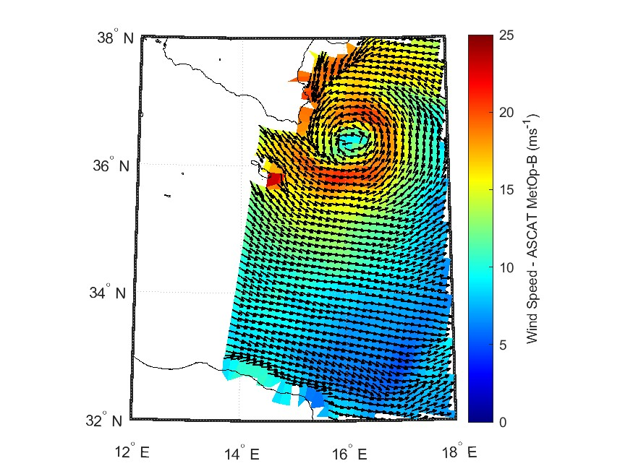
What is a Medicane?
Tropical-like cyclones that develop over the Mediterranean Sea.
Based on satellite data, there are three components to a medicane as defined by Miglietta et al.
Spiraling cloud structure
and rainbands around
an almost-cloudless ‘’eye’’
Nearly-closed surface wind field with maximum speed within a few tens of km from the center
Presence of Warm Core
MW vertical cross-section of TB anomaly for medicane Zorbas, 29 Oct. 2018.
Medicane “Numa” MODIS Terra
VIS image, 18 Nov. 2017
Medicane “Apollo” ASCAT wind field
29 Oct. 2021
Notes:
My project aims to identify this last component of a Medicane, the nearly-closed ring of surface wind.

Slide 3
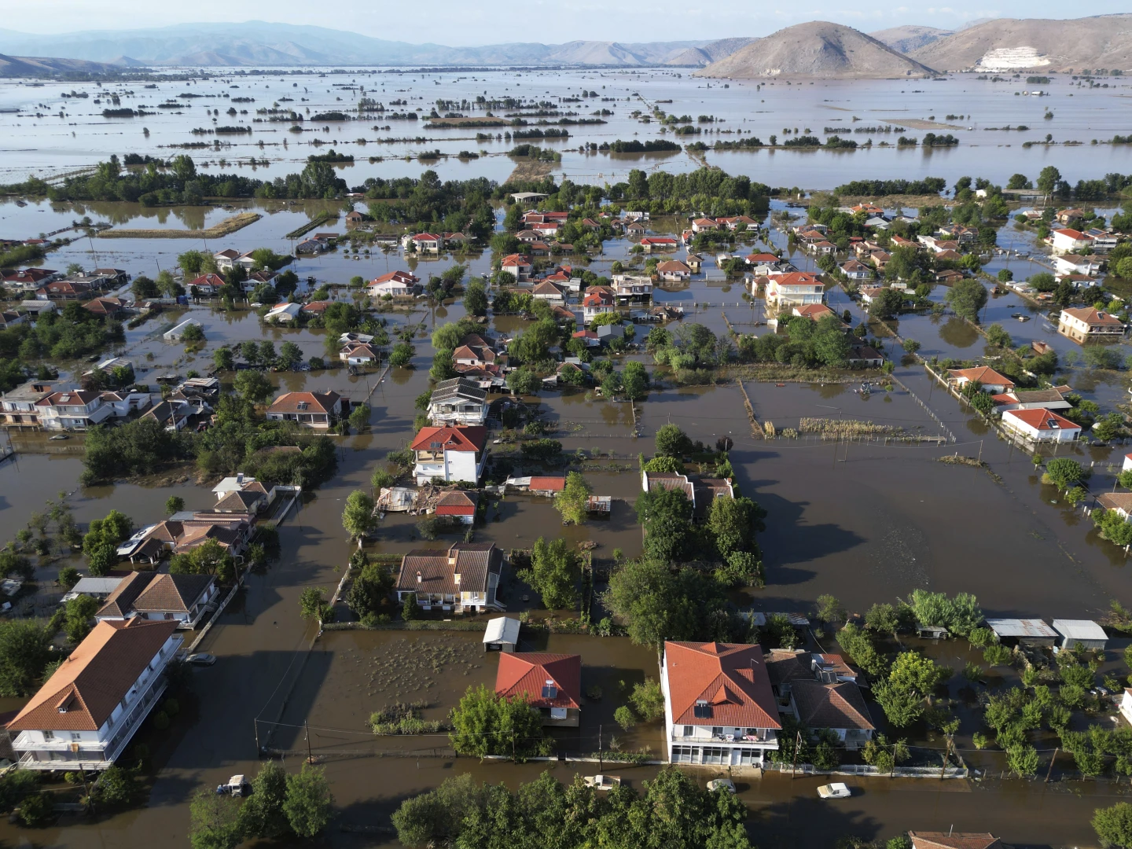
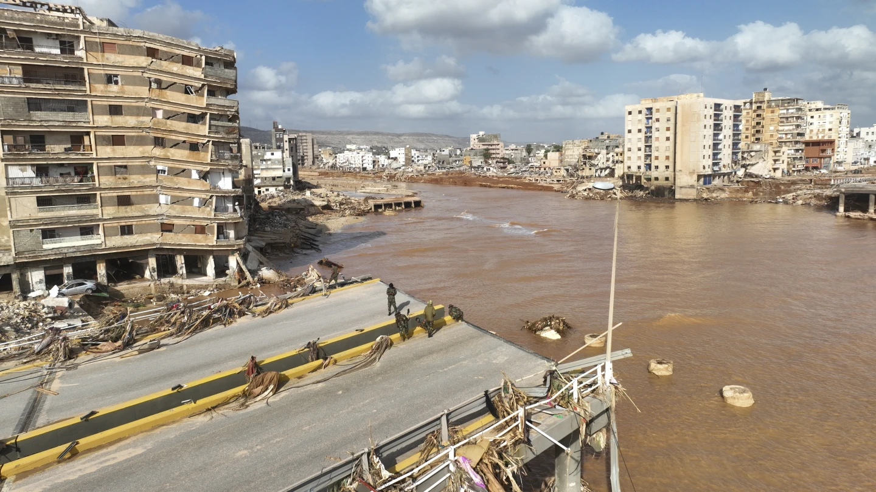
Negative Impact of Medicane Daniel (5-10th Sept. 2023)
Affected cities in Greece and Libya
Excessive rainfall collapsed two dams
Over 5,000 fatalities and 10,000 people missing
Buildings, communication lines, power networks fell
Images by Vaggelis Kuosioras @ Associated Press
Notes:
Before I talk about my project, I want to talk about how dangerous Medicanes can be by looking at one of the most devastating examples, Medicane Daniel. Daniel initially formed in the Ionian Sea in 2023, west of Greece, and followed a path along the coast of Northern Africa, affecting coastal cities in Greece and Libya. It lasted from September 5 to 10th and its excessive rainfall led to collapse of two dams in Libya, causing massive flooding and damages to the infrastructure, as seen in these images. This event caused 5,000 deaths and 10,000 people to go missing.
So while Medicanes only occur once or twice a year, they can be devastating, especially to areas lacking funds, resources, or the infrastructure to protect themselves against Medicanes. Also, climate change is increasing the sea surface temperature of the Mediterranean Sea that could increase the intensity of Medicanes in the future.

Slide 4
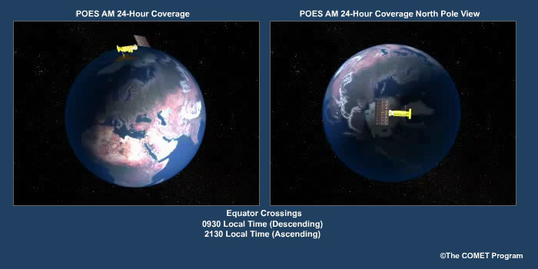
Advanced Scatterometer (ASCAT) Data
An active microwave instrument that measures near-surface wind speed and wind direction from the roughness of the sea surface
Processed by the Royal Netherlands Meteorological Institute (KNMI)
Has a resolution of 12.5 km and onboard three satellites (MetOp-A, MetOp-B, MetOp-C)
Data is Available at EUMETSAT website, “ASCAT Coastal Winds at 12.5 km Swath Grid – Metop”
Notes:
So let’s talk about one of the ways we analyze Medicanes. We use data from an advanced scatterometer, also known as ASCAT. ASCAT measures the near-surface wind fields, specifically the wind speed and the wind direction over the ocean.
It is an active microwave instrument that sends a signal that reaches to the sea, and due to the roughness of the sea surface, one can derive the wind speed and direction from the backscattered signal
The signal is processed by KNMI and publicly available on the EUMETSAT website.
It has a resolution of 12.5 km and there are three of these instruments on three different satellites, though MetOp-A is no longer working. The satellite orbits the Earth in the way as shown in this video.

Slide 5
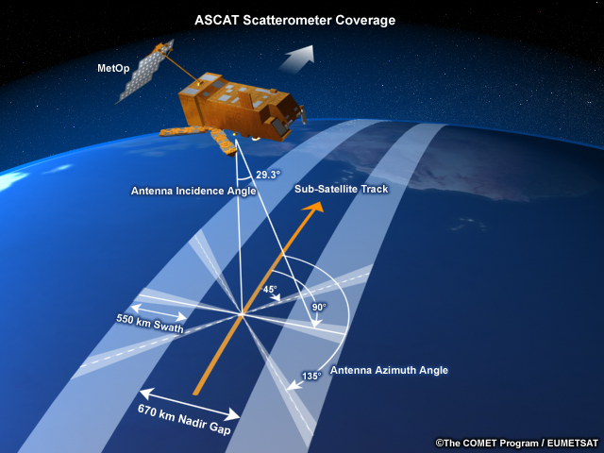

How does ASCAT work?
Consists of two 550-km swaths separated by a 700-km gap
Uses a pushbroom scanning
Limitations of ASCAT
A Medicane in a gap is not recorded
Spatial resolution of scatterometer tends to underestimate higher wind speeds (above 30 ms^-1)
Locations in the Mediterranean Sea will be recorded a minimum of twice per day
Source: Stoffelen et al. (2021) and Ni et al. (2022)
Notes:
So I want to talk little about how ASCAT works. So ASCAT records wind direction and wind speed alongs two swaths, which is the light blue lines in the top right figure. And between the swath is a gap where no wind data is recorded. And these ASCAT uses a pushbroom scanning technique as seen in the bottom right. It involves a scanner with a row of senors that simultaneously records a line of data.
Now some of the limitations of ASCAT includes how if there s a medicane within a gap, it will not be recorded by ASCAT. This causes some data to be lost. Also, the ASCAT tends to underestimate higher wind speeds, but that doesn’t affect me because I am focusing more so on the circulation of the wind vectors than the wind speed. Finally, at locations at the Mediterranean Sea will be viewed a minimum of twice per day, which reduces the amount of data available.

Slide 6
Examples of Closed Ring of Maximum Wind
Figures by Stefano Sebastianelli from his algorithm, Medicane Rotational Center Automated Detection (MeRCAD)
Juliette in Development Phase
Ianos in Mature Phase
Notes:
So I want to show examples of where we see this nearly-closed ring of surface wind from ASCAT data over the eyes of two Medicanes. These figures are from a colleague named Stefano through his algorithm called MeRCAD. In each figure, the white arrow is pointing to the purple cross that represents the center of the cyclone from Stefano’s algorithm. The blue dot is the center of the cyclone by another model based on reanalysis data, but is less accurate than the purple cross. Lastly, the red dot represents the radius of maximum wind, also from Stefano’s algorithm. Each graph consists of vectors that represent the direction of the wind and the colorbar on the right represents the intensity of the wind.
In the left figure, we see the circular wind around the center of Medicane Juliette in its Development Phase, meaning the early formation of the Medicane. In the right figure, we see something similar at the center of Medicane Ianos at its mature phase, or its most intense phrase. A you can see, the radius of maximum wind decreases as it transitions from its development to its mature phase.
So, the goal of the project is to train a machine learning model on ASCAT wind data to detect the presence of a closed ring of maximum wind speed

Slide 7
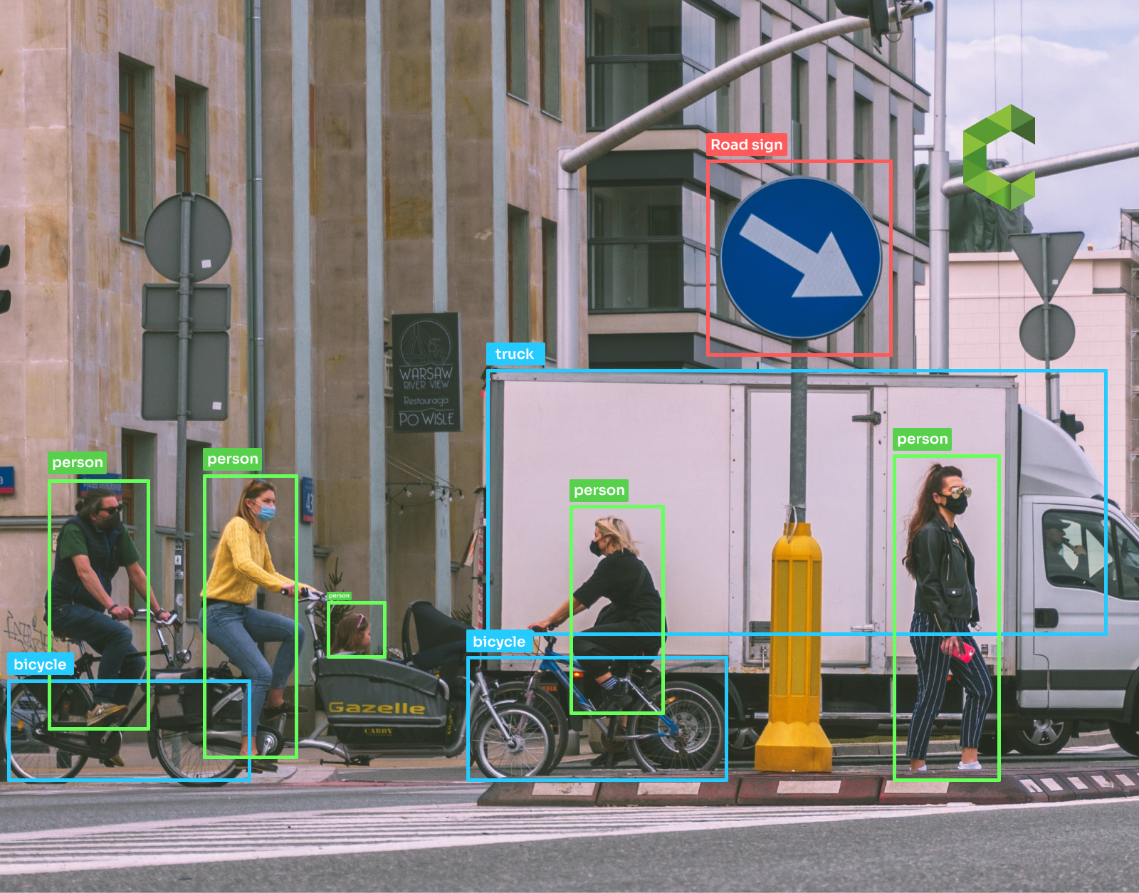
Applying Object Detection
What is object detection?
Creating boundary boxes around objects and classifying them
Why use object detection?
Verify that the model is learning from the object
Source: Plugger.ai, 2023
Notes:
So the machine learning technique I will use falls in the field of object detection. Object detection is a computer vision technique that identifies and locates objects by drawing a boundary box around the object and labeling said boundary box. So you can imagine how this would work for my project, given ASCAT data of wind field, we would want our model to draw a boundary box around the closed ring and determine whether it is or is not a closed ring of maximum wind speed.
The benefit of using object detection here is that I can ensure that the machine learning model is learning from the right features of the data, instead of learning from an unknown bias feature.

Slide 8
Reference Paper
Figure 2. Flowchart of cyclone/anticyclone detection algorithm.
Source: Ming Xie, et al (2020)
Notes:
I want to mention that the use of object detection is inspired by another research paper, where given the Northern and Eastern wind speed, or the x and y component of wind speed, the machine learning model will draw a boundary box at center of the cyclone and label the boundary box as either a clockwise or counterclockwise rotating cyclone.

Slide 9
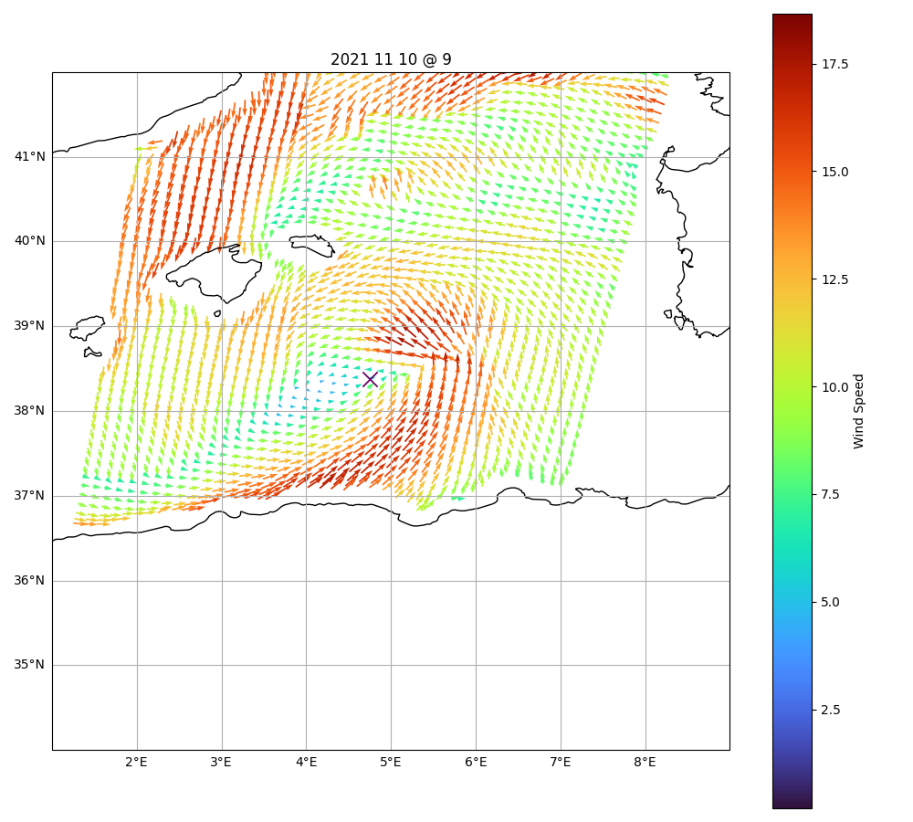
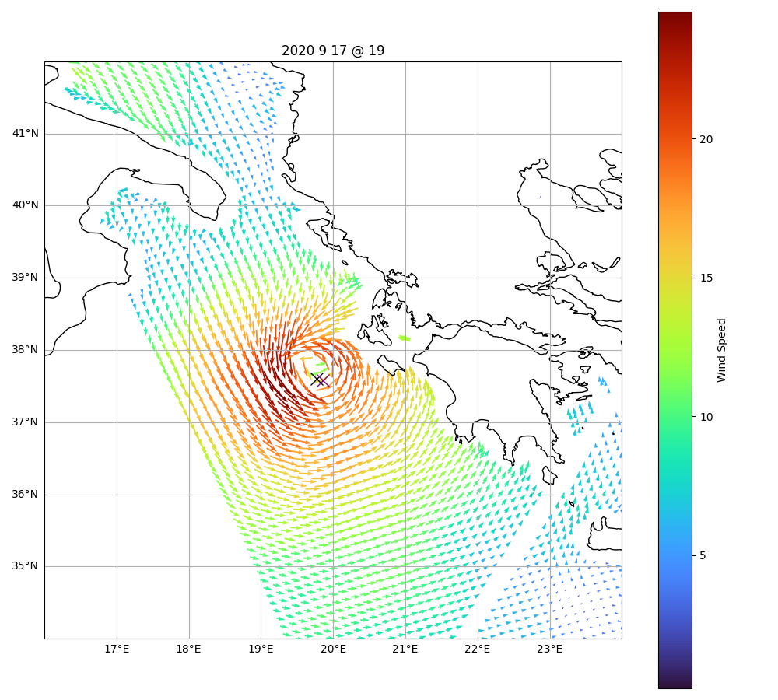
Dataset
Number of labeled overpasses: 831 from years 2010 – 2023
Covers 213 cyclones
No boundary box labels yet
Still a work in progress
Notes:
So what I have done so far and still in the process of preprocessing the data. So far I have collected 831 overpasses that are labeled as either a closed ring or not. The left figure here is an example where we wouldn’t see a closed ring even with the center of the cyclone known, while the right side is an example of closed ring. This dataset includes 10 medicanes and 203 other cyclones, annotated by Stefano’s own algorithm. No boundary box labels are created yet and this dataset is still a work in progress.
So the future plan is to finalize the dataset, decide on what specific object detection technique I want to apply, and train and finetune this model to improve accuracy

Slide 10





Acknowledgements
Thank you for listening! This research has been supported by the High Meadows Environmental Institute (HMEI) at Princeton University, the Institute of Atmospheric Science and Climate of the Italian National Research Council (CNR-ISAC), and the European Space Agency (ESA) MEDICANES Project.
“Earth Observations as a cornerstone to the understanding and prediction of tropical-like cyclone risk in the Mediterranean
https://medicanes.isac.cnr.it/
MEDICANES is funded by the European Space Agency Contract No. 4000144111/23/I-KE

